Slide 1
Introduction to Cloud Native Computing
Docker, Kubernetes, and Scalability
Connor Boyle

Slide 2
Motivating questions
What is “The Cloud” / “cloud native computing”?
How are cloud native apps different from other apps?
Which technologies support cloud native computing?
Many companies are becoming software companies, even if they aren’t in the software business. Why?

Slide 3
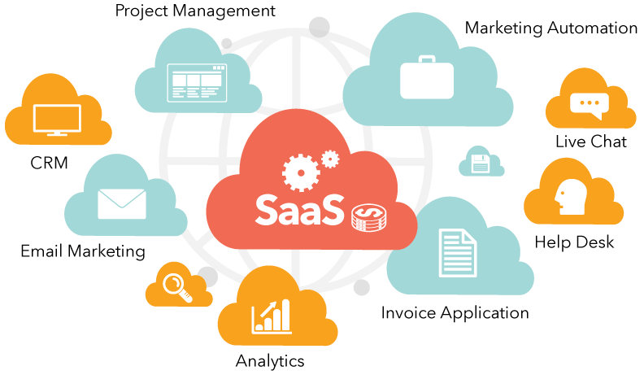
The Cloud is more than a storage platform
Remote internet services vs. local applications
Google Drive / Dropbox
Office 365
Adobe Creative Cloud
Github
SaaS – Software as a Service

Slide 4

Problem 1: Dependency on Server OS

Slide 5
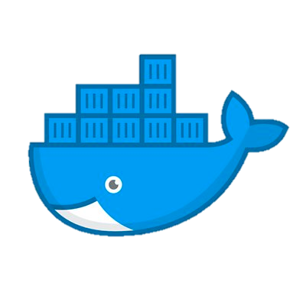
Solution 1: Virtualization

Slide 6
Problem 2: We need more resources!

Slide 7
Solution 2: Vertical Scaling

Slide 8
Problem 3: Vertical Scaling doesn’t work
down time
maximum capacity
expensive!

Slide 9
Solution 3: Horizontal Scaling

Slide 10
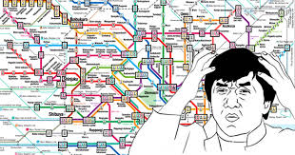
Problem 4: We can’t manage the cluster!

Slide 11
Solution 4: Container Orchestration

Slide 12

Cloud Native Computing Foundation
CN applications use an open-source software stack:
Containerized
Dynamically orchestrated
Microservices-oriented
Modern companies need cloud native computing:
allows IT and software to move faster
enables companies to create software in-house
keep up with competitors and deliver better services
enables cloud portability without vendor lock-in
Notes:
Containerized. Each part (applications, processes, etc) is packaged in its own container. This facilitates reproducibility, transparency, and resource isolation.
Dynamically orchestrated. Containers are actively scheduled and managed to optimize resource utilization.
Microservices oriented. Applications are segmented into microservices. This significantly increases the overall agility and maintainability of applications.

Slide 13
Kubernetes runs on all popular cloud providers

Slide 14
Demo

Slide 15
What drives people to develop CN apps?
Non-functional requirements
Software process model

